Slide 1
CSC Sparks Analysis
Iurii Bordulev, Aleksandr Khodinov, Sergei Rosliakov

Slide 2
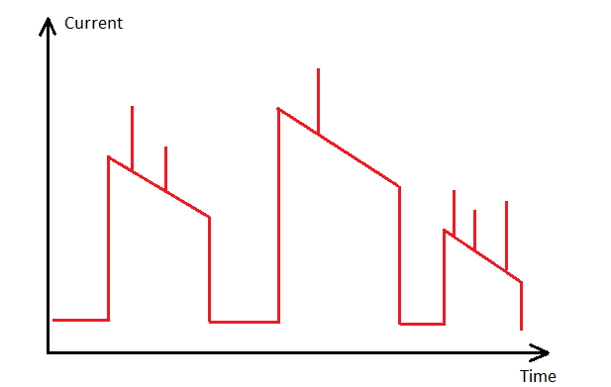
The Task
Stand by period = low current
Stable beam period = high current
What to find: Current sparks in Stable beam periods

Slide 3
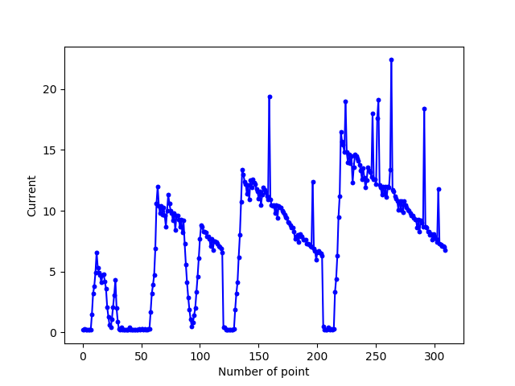
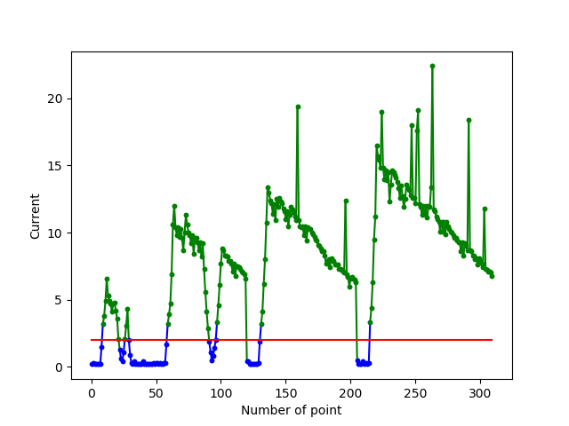
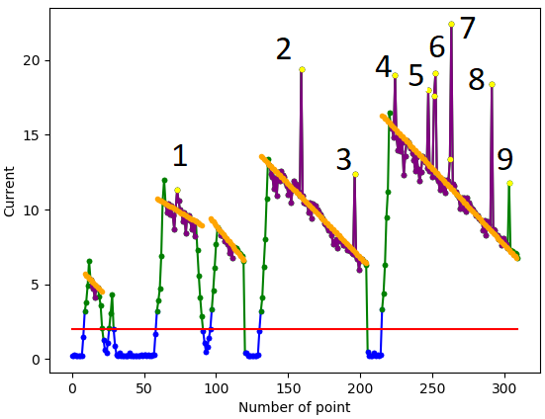
Implementation
Step 3:
Define the Stable beam region
Fit the baseline
Define the threshold (for sparks)
Detect the spark
Step 1: Analyze the current data
Step 2:
Define the threshold (for stable beam)
Choose region above threshold

Slide 4
Implementation
Step 2. The threshold (for Stable Beam region)
The data for HV are used
When the HV is nominal, I count the avg current
The avg. current + threshold value (defined by user) = Threshold for Stable Beams

Slide 5
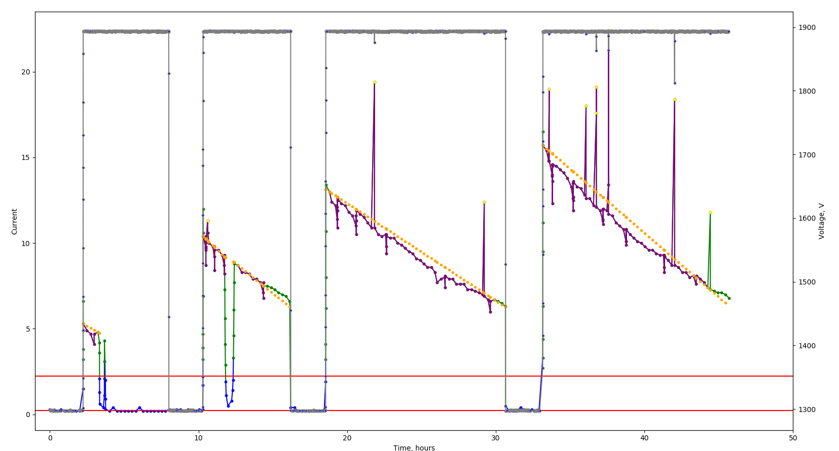
Implementation
Step 2. The threshold (for Stable Beam region)
Voltages

Slide 6
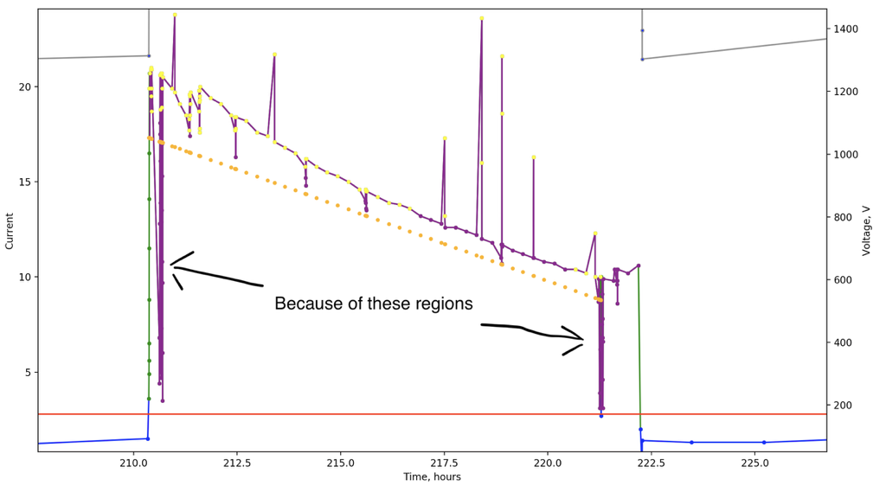
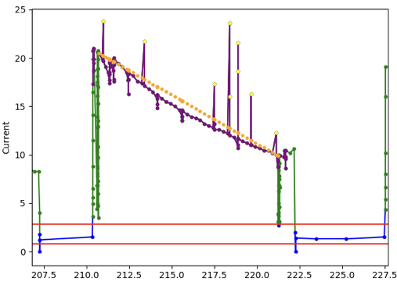
Implementation
Step 3. Define the Stable beam region
Fight with regular current falls in 2018 data

Slide 7
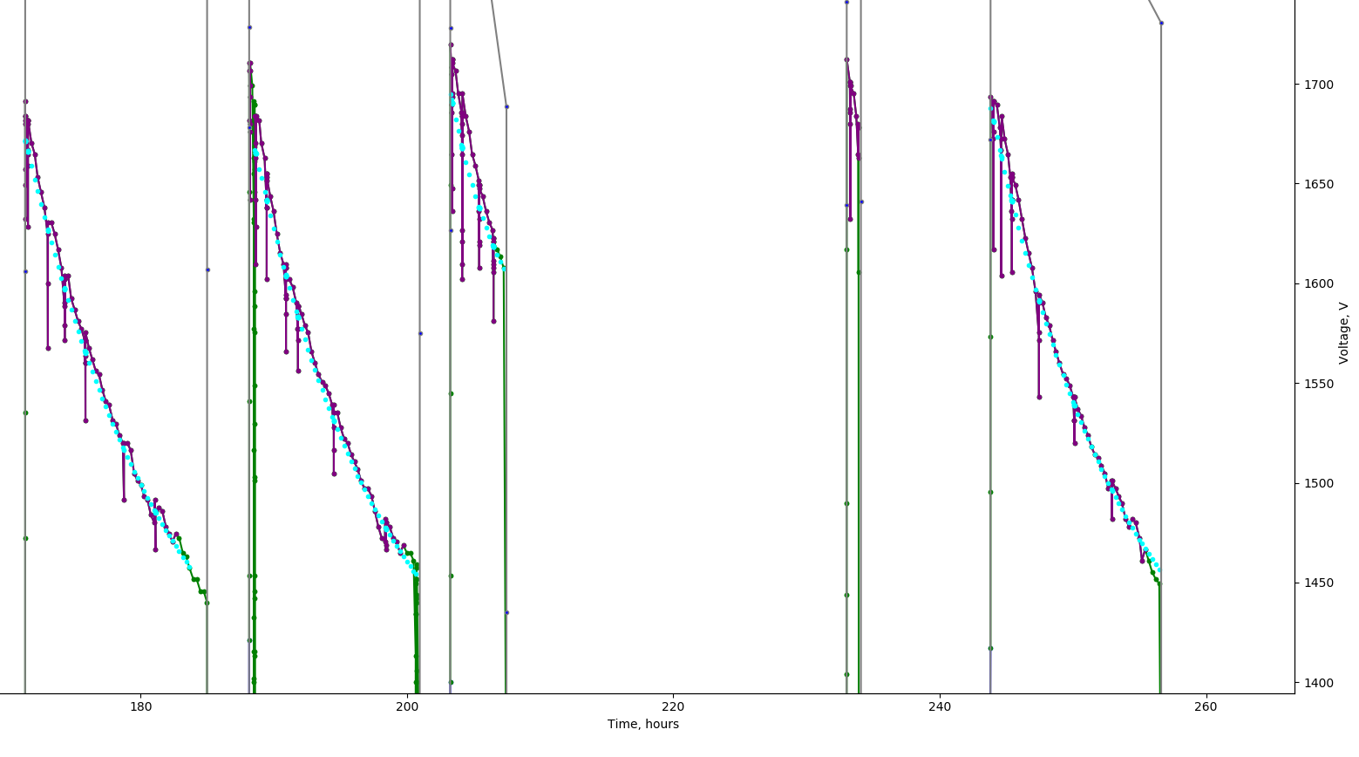
Implementation
Step 3. Fit the baseline
With exponent

Slide 8
Implementation
Step 3. Define the threshold (for sparks) above the baseline
Higher the baseline value –> higher the baseline oscillations –> the threshold should be higher not to detect the oscillations.
When the run is long (> 5 hours) – the baseline oscillations in the middle of the run is also lower –> the threshold could be smaller to detect smaller sparks
The dynamic threshold were introduced (dependent on the baseline value and the length of the run) = 1 – 2 microAmps

Slide 9
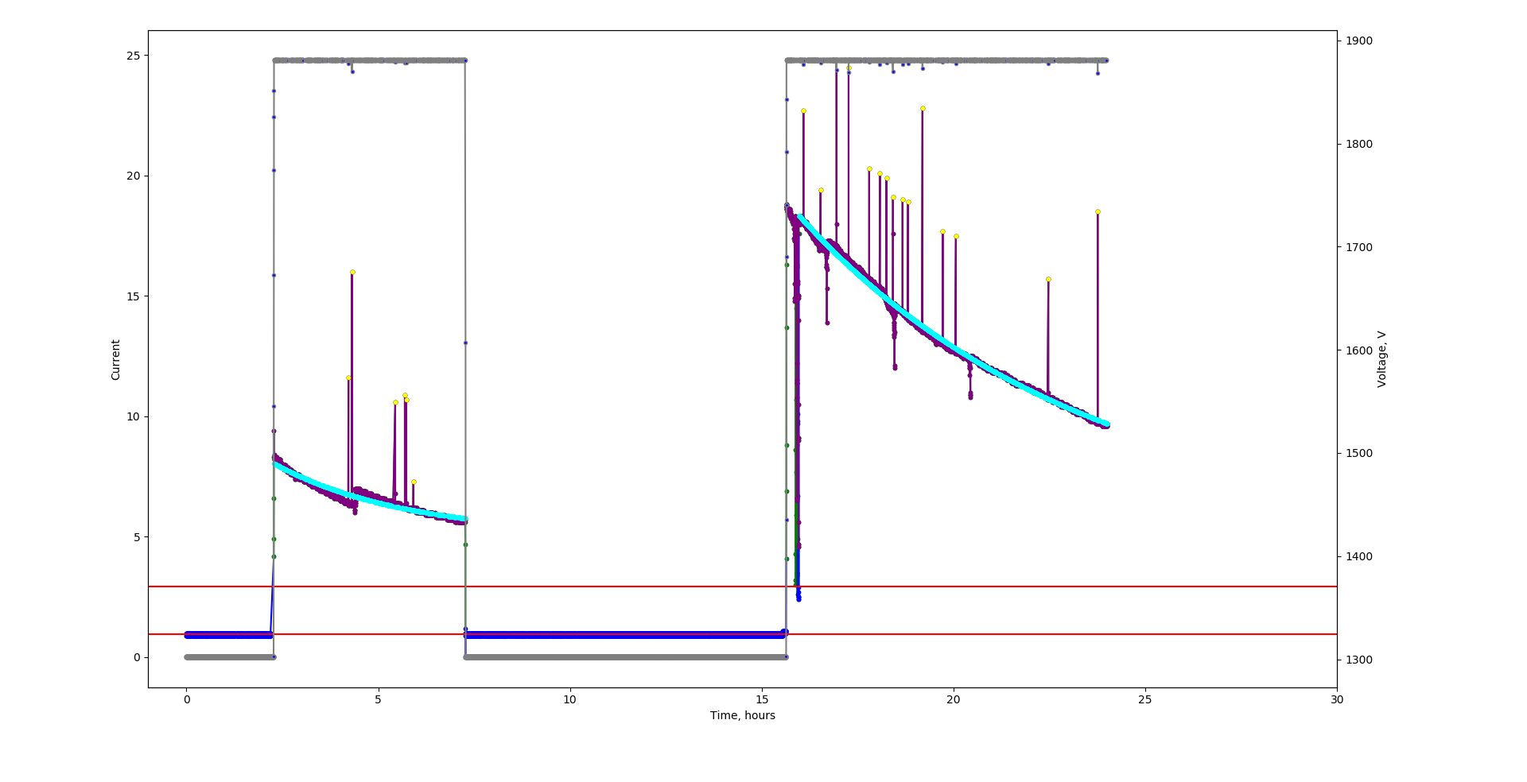
Implementation
Step 3. Define the threshold (for sparks) above the baseline

Slide 10
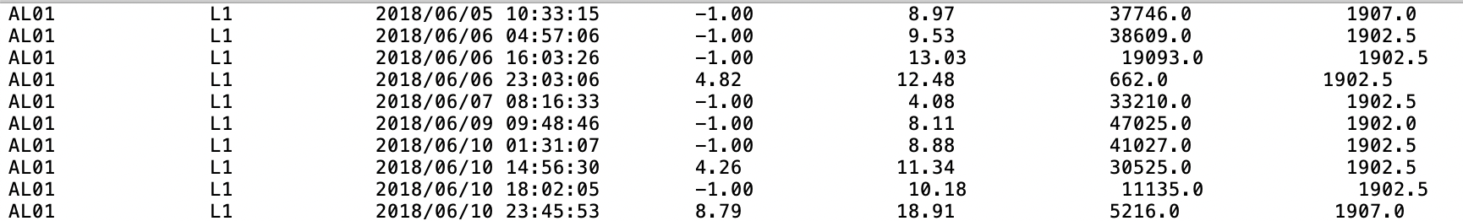
Implementation
Step 3. Detect the spark
Parameters of sparks:
Chamber; layer; time stamp; Amp; Bline; Timediff; HV

Slide 11
Algorithm
Part I
CRON
Python scrip
Download data
Currents; HV
Launches everyday at 00:00
Location: @aiatlas066.cern.ch:/data/software/python3/baranov/sparkcounter
Process the data
Repeat for every layer
Add entry to database
Database
Remove data
Part II. When all layers processed
C++ script
Analyze database
Make a root tree
Root Tree

Slide 12
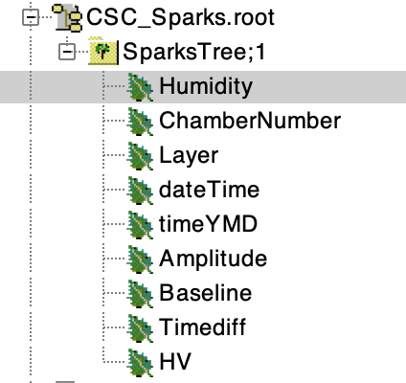
Root tree
[ppm]
Positive – A side; Negative – C side
[1-4]
[seconds since Jan 01 1970]
[microAmps above baseline]
[microAmps]
[seconds]
[Volts]

Slide 13
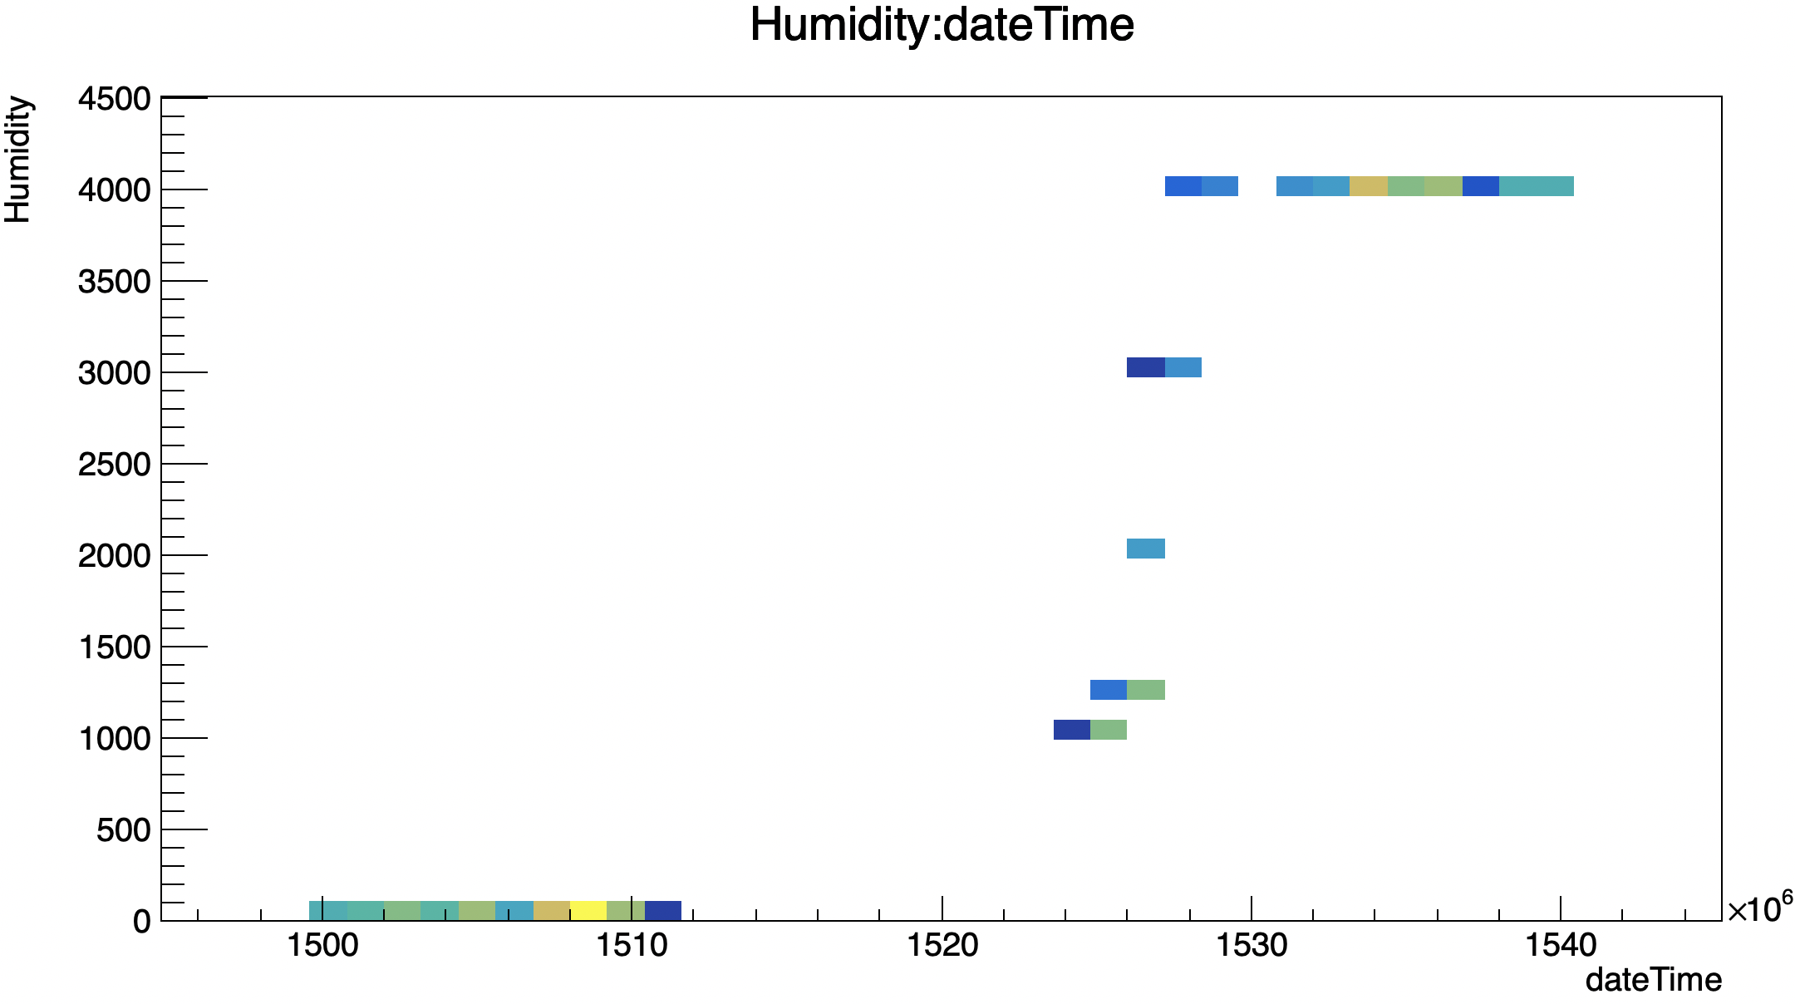
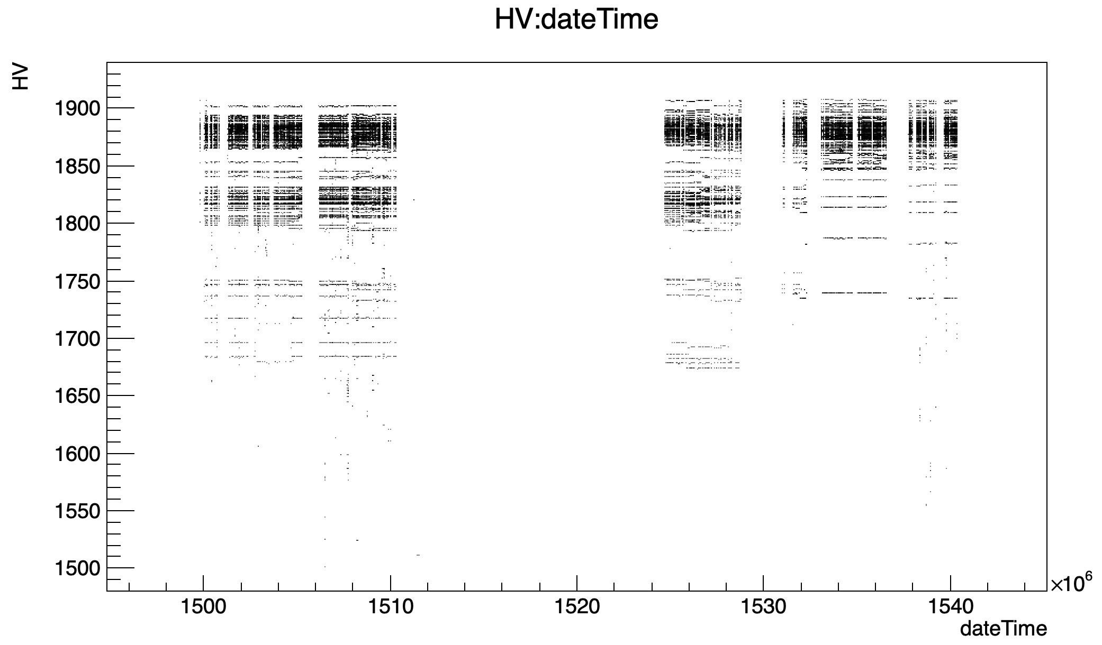
Changed parameters
Humidity
HV

Slide 14
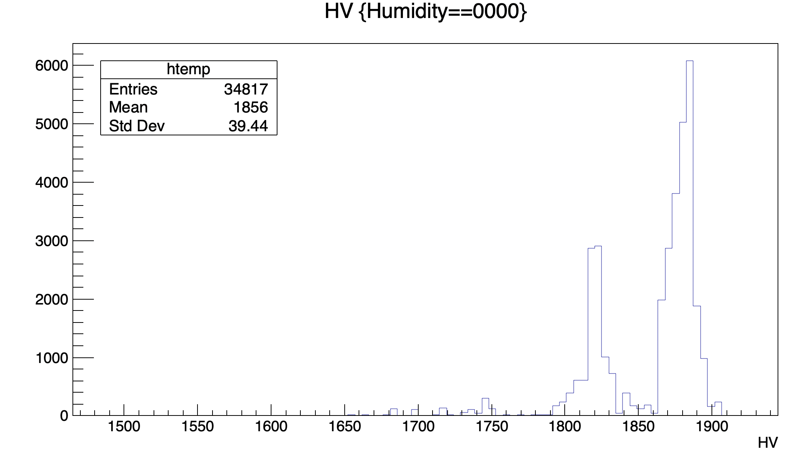
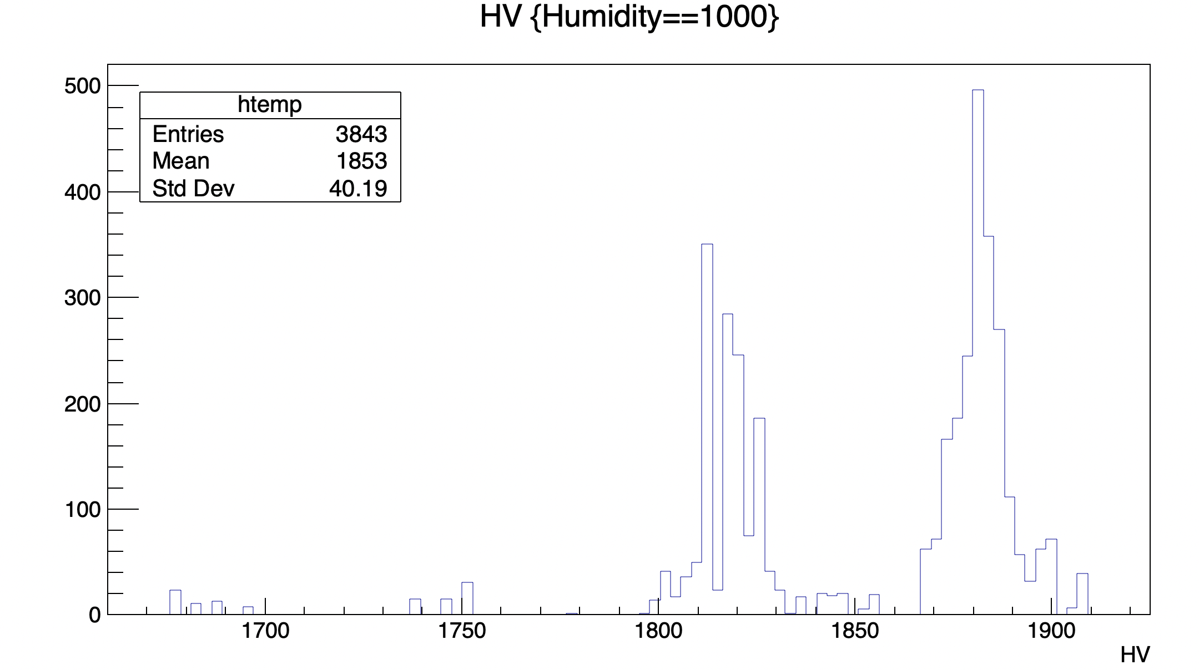
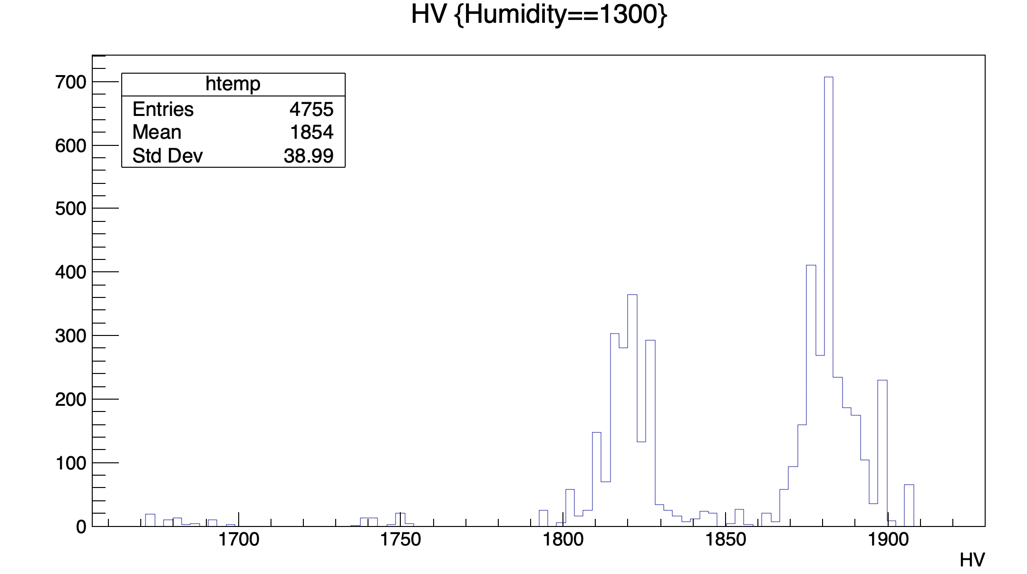
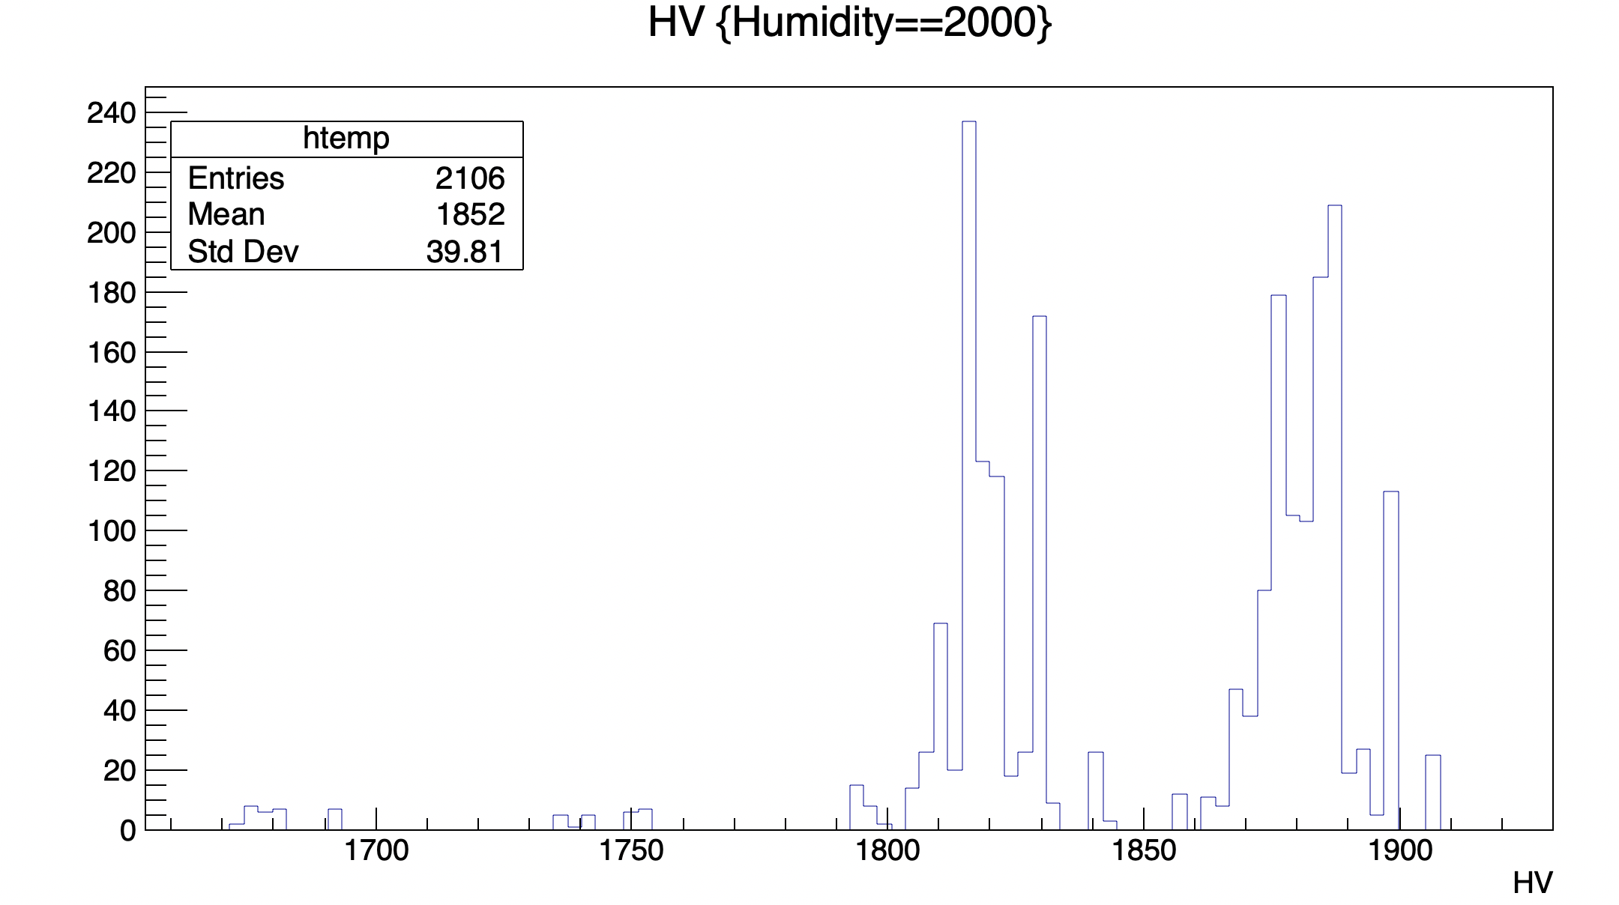
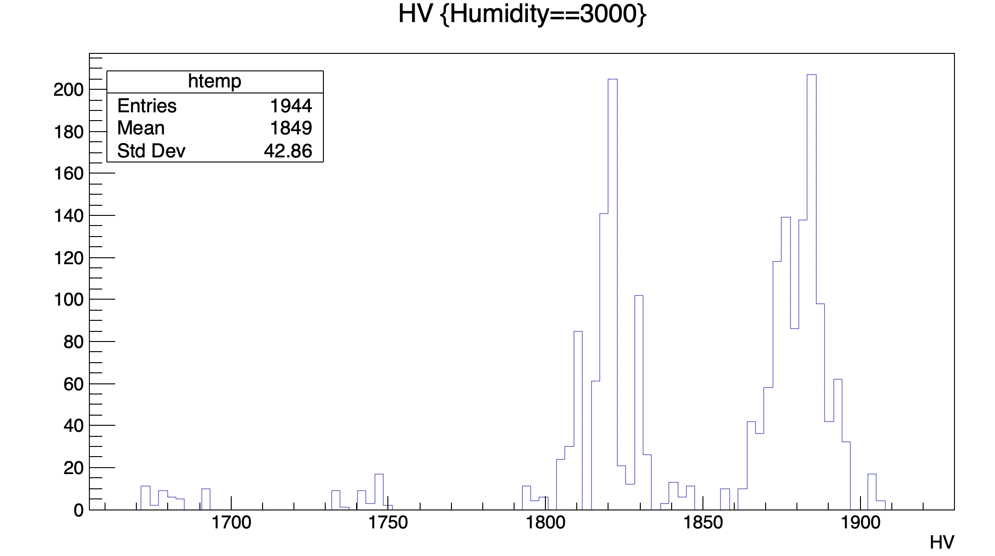
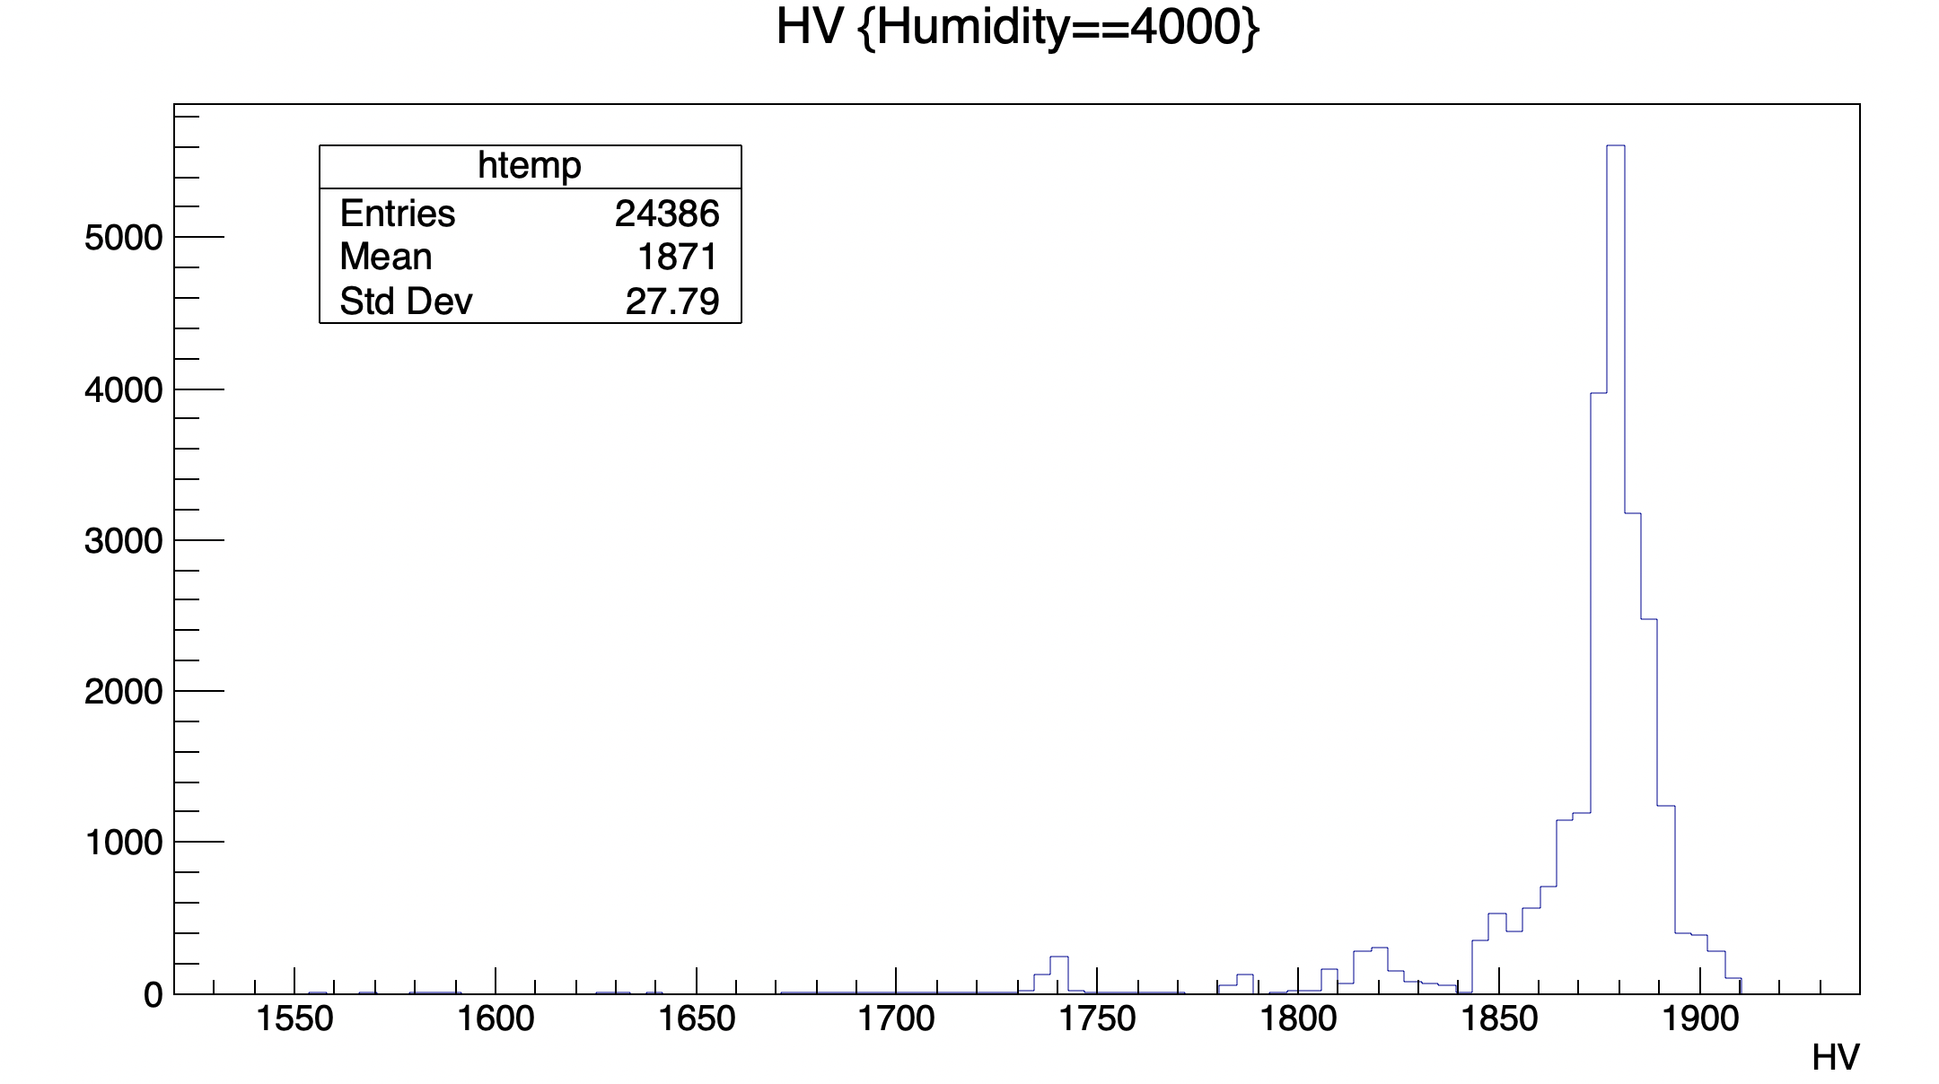
HV

Slide 15
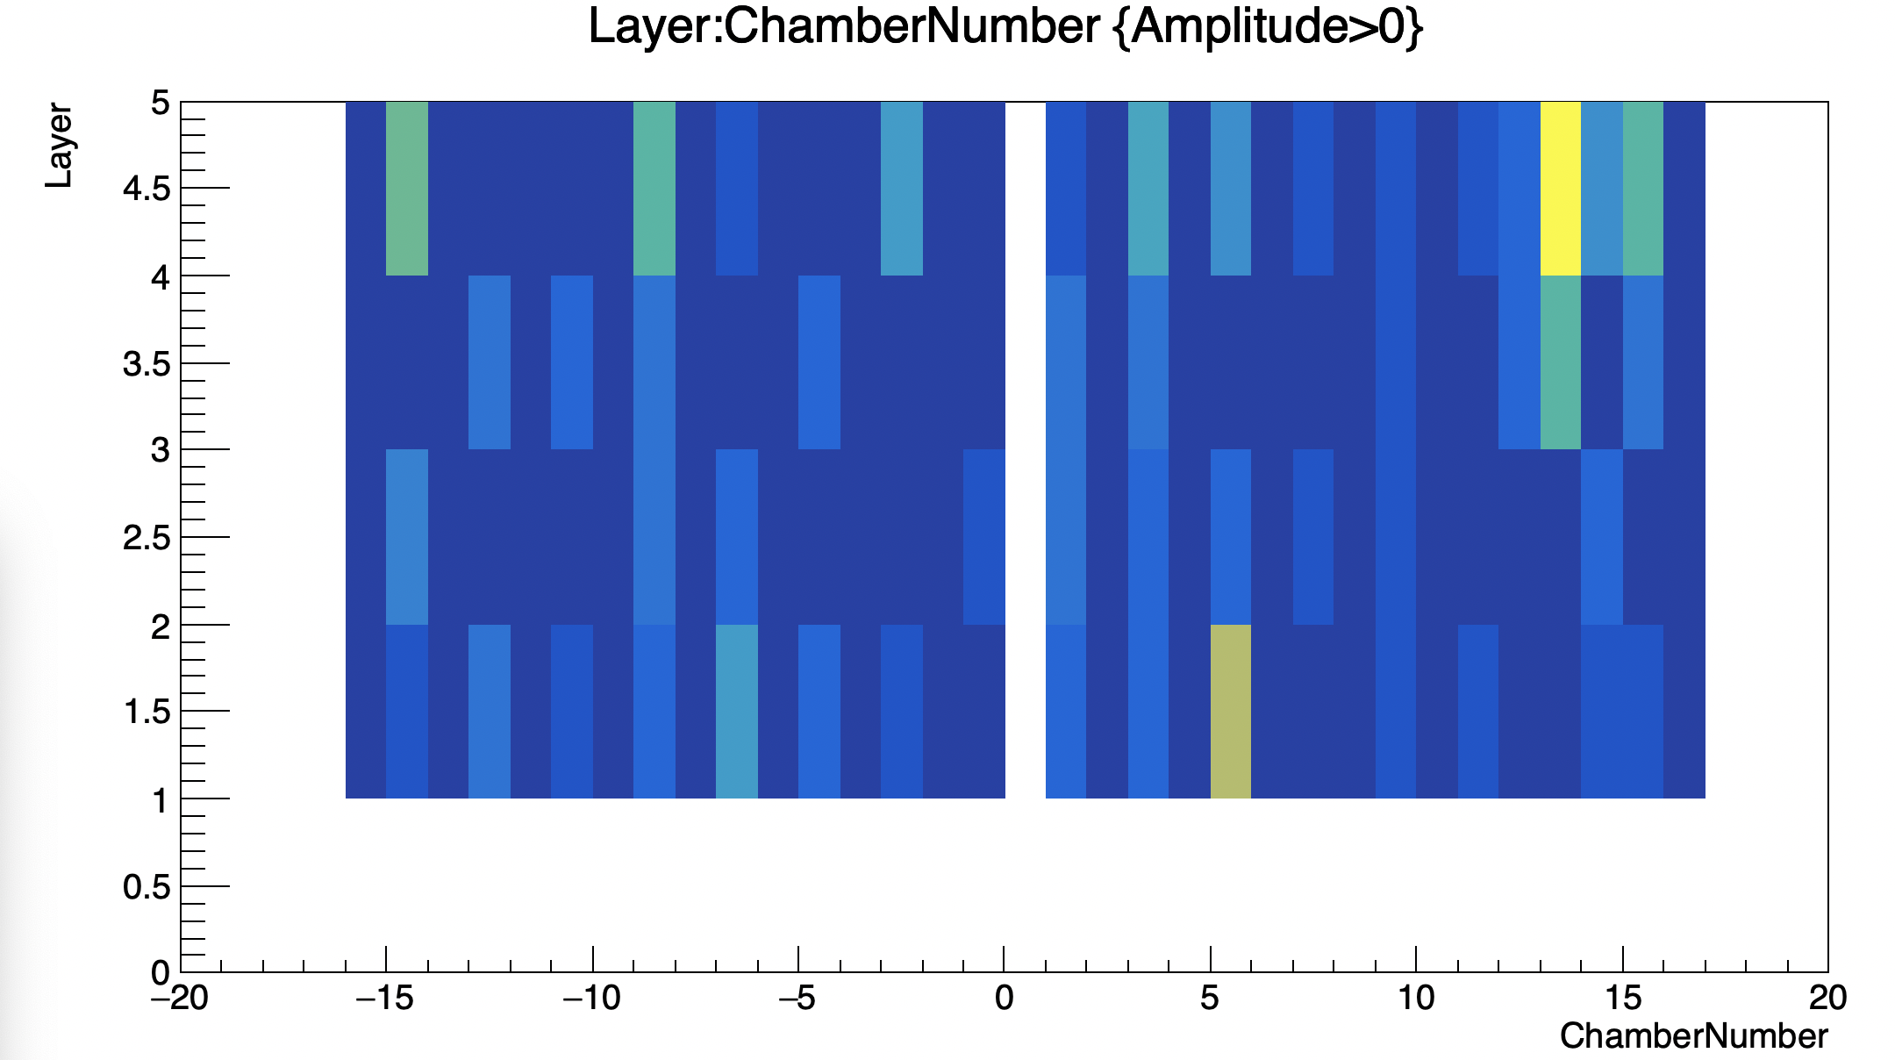
Chambers and layers (Statistics)

Slide 16
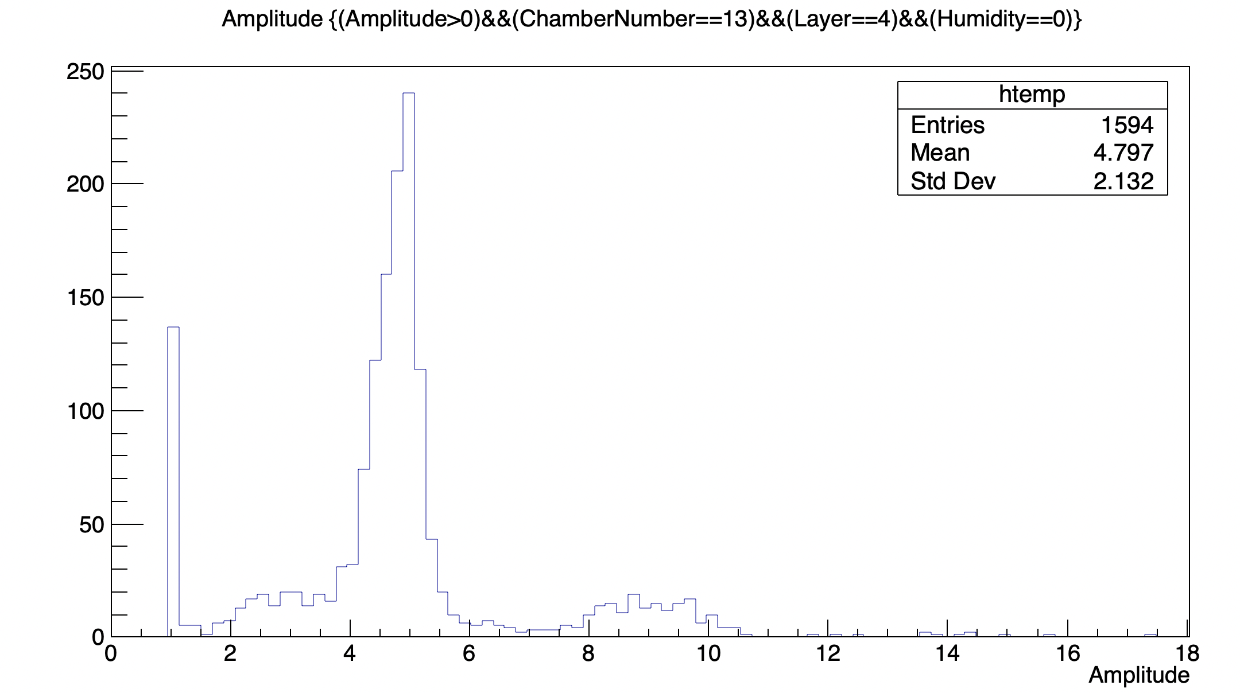
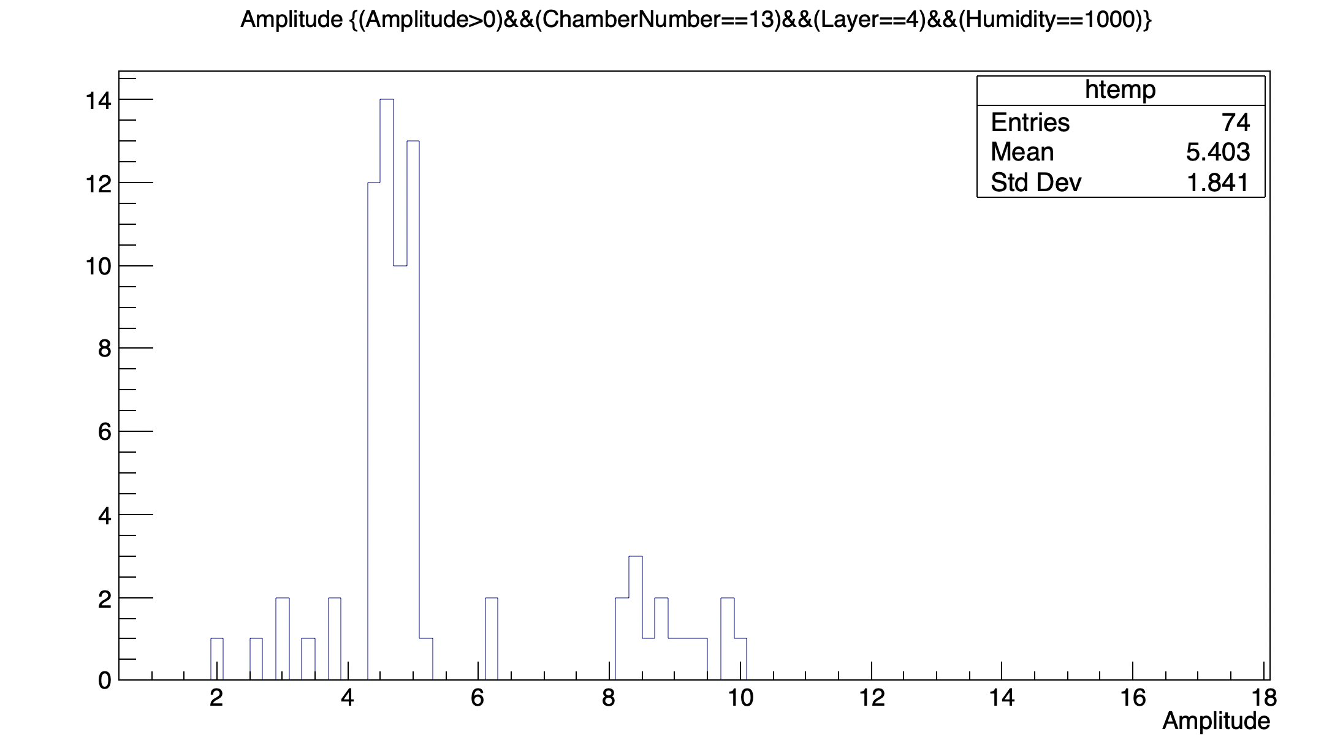
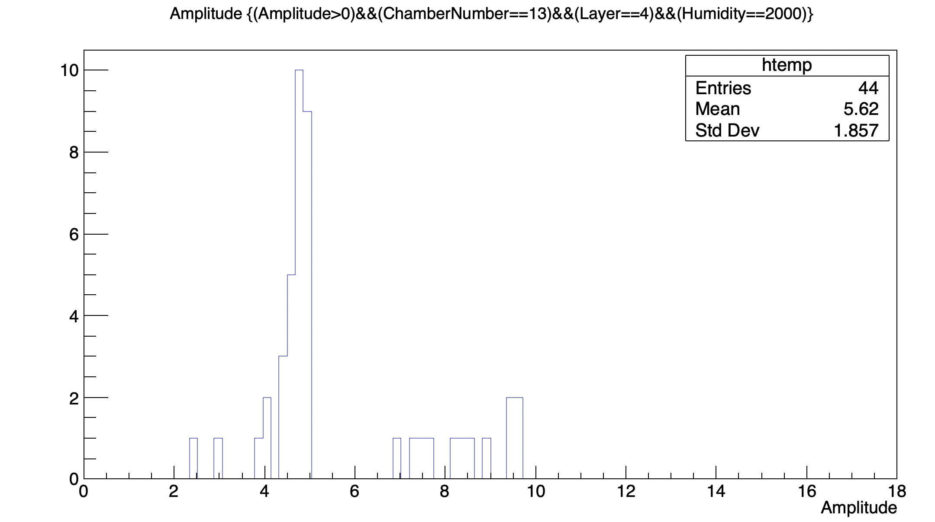
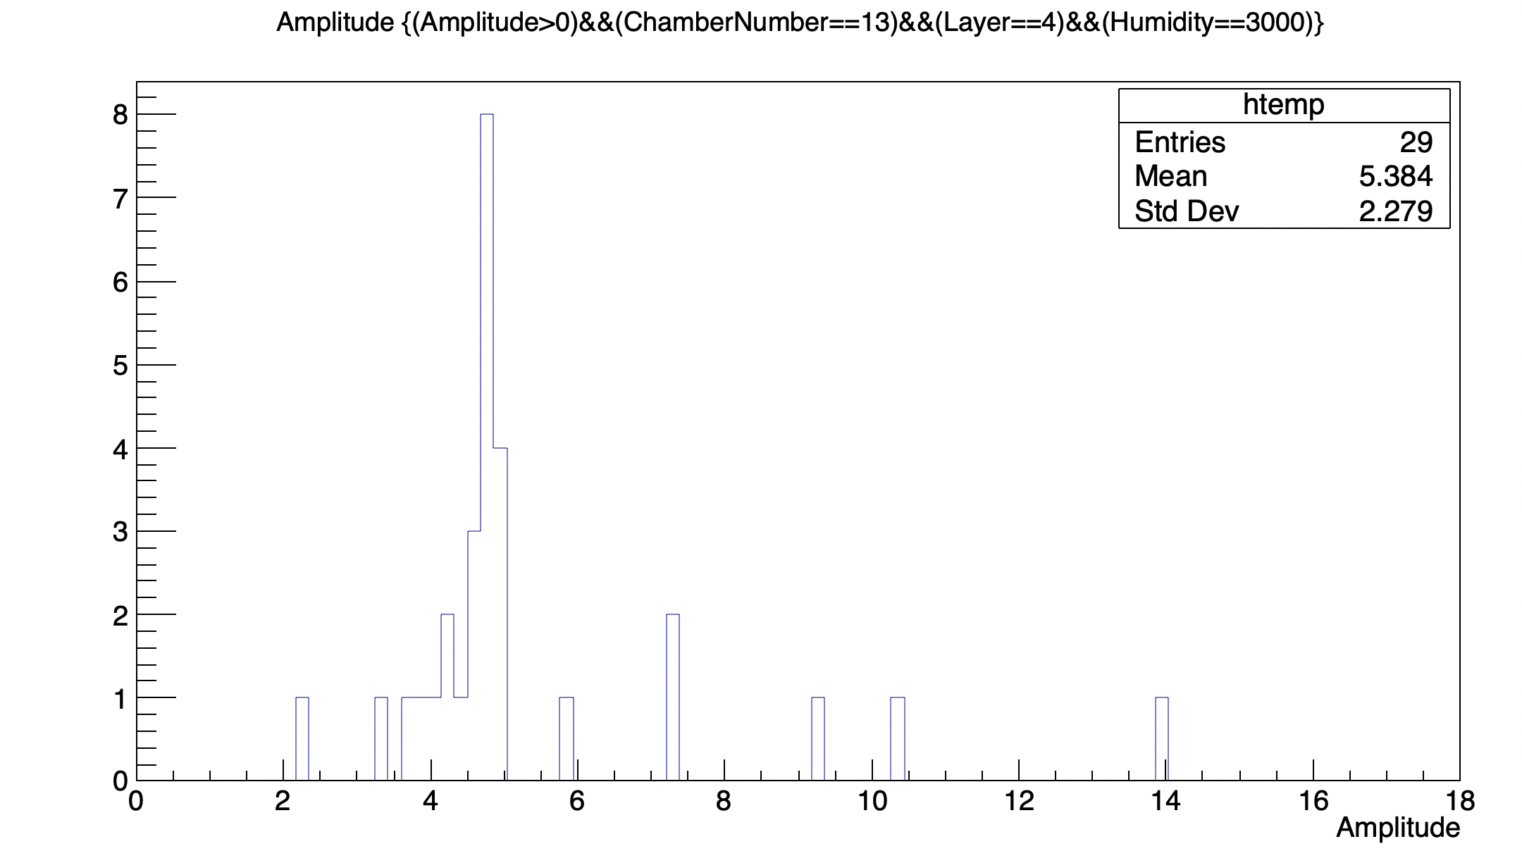
Amplitude Distribution at different Humidity

Slide 17
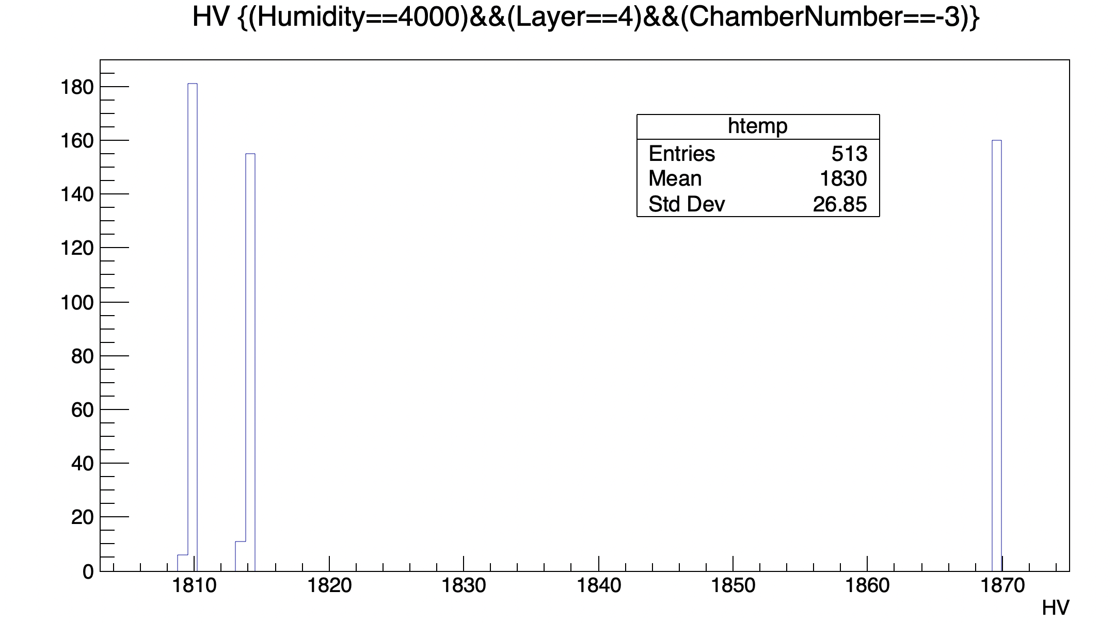
HV

Slide 18
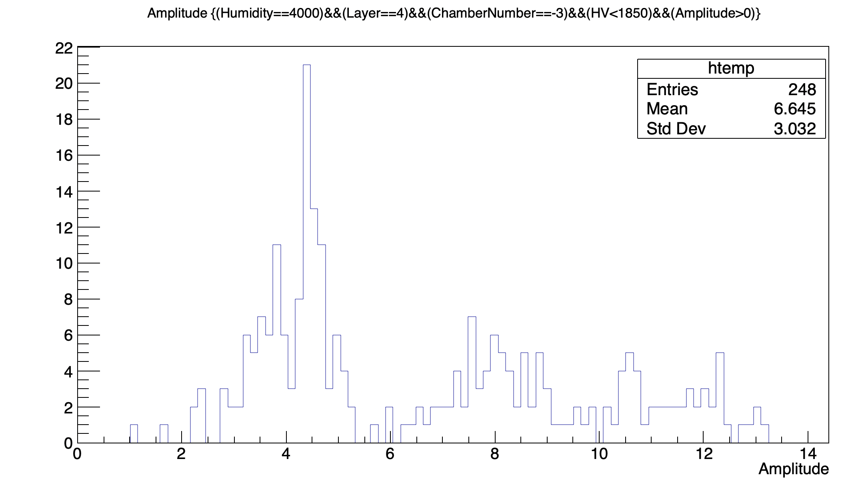
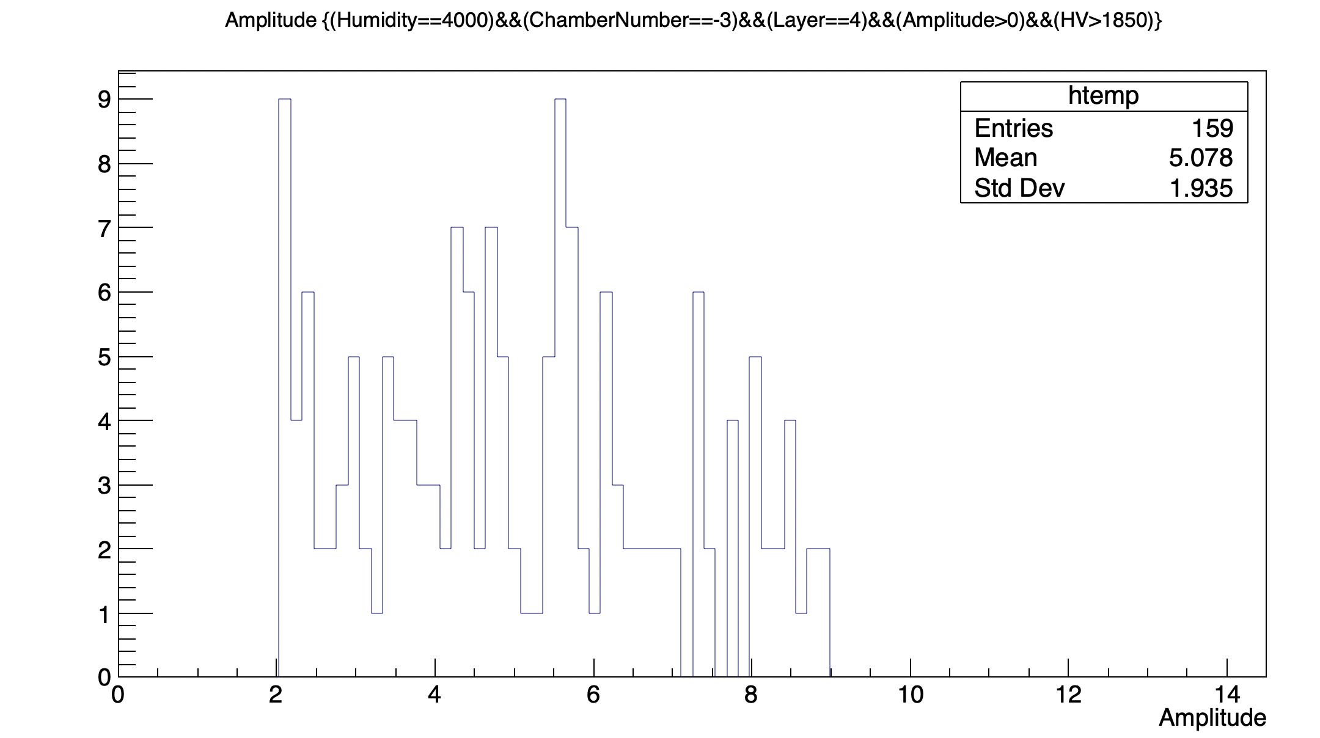
Amplitude distribution with different HV

Slide 19
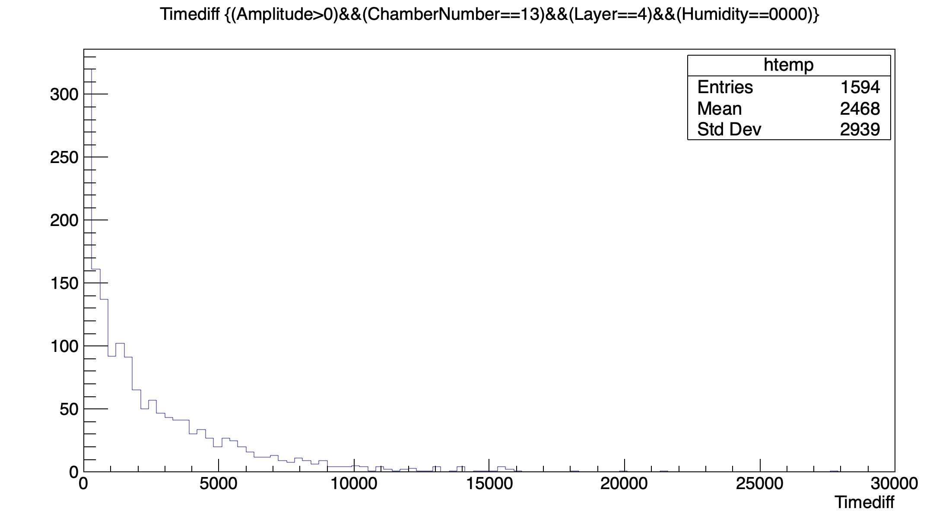
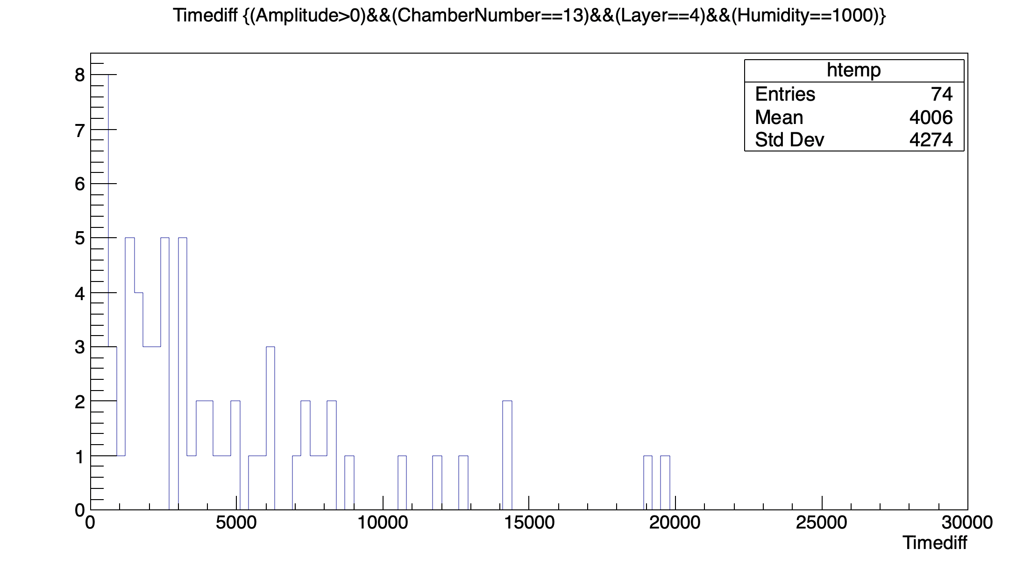
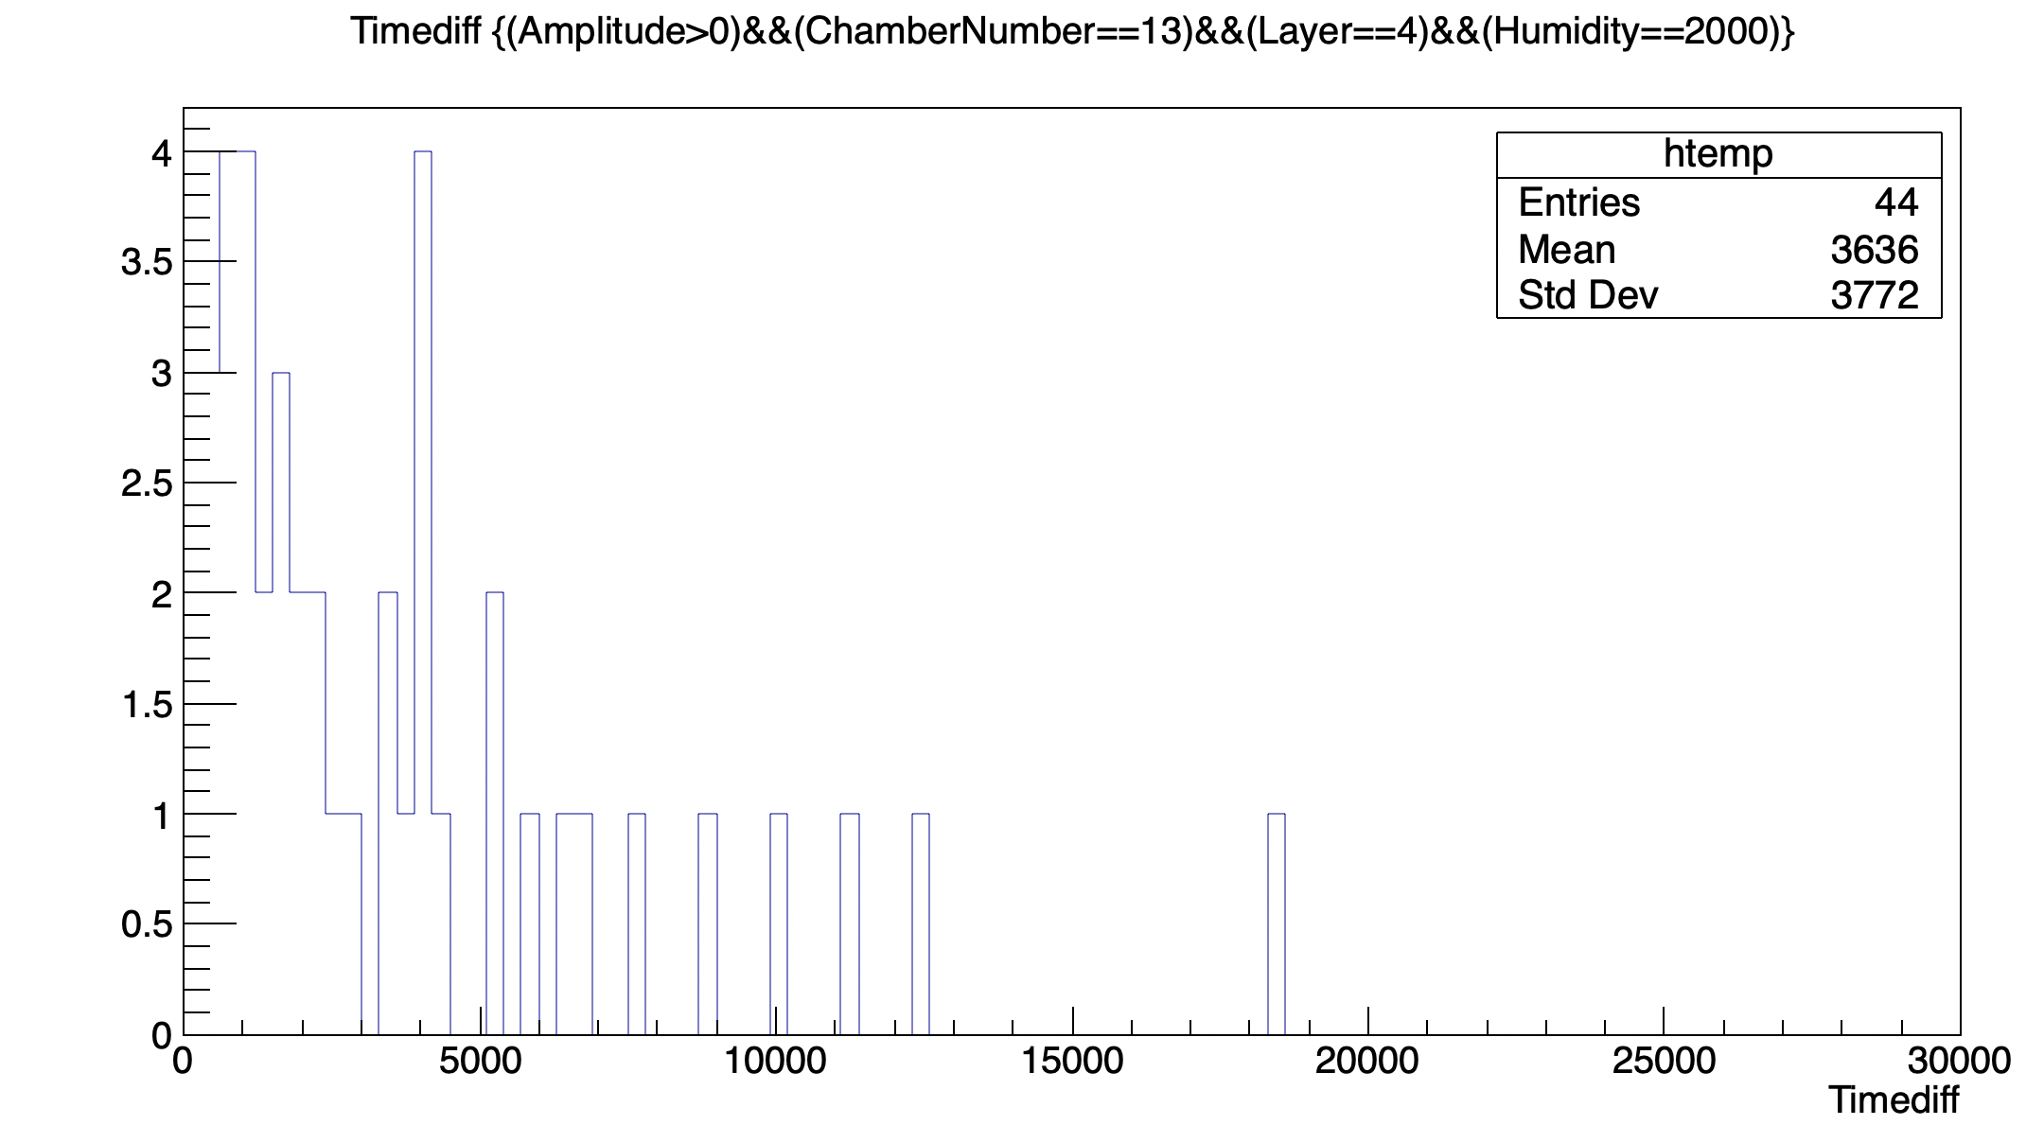
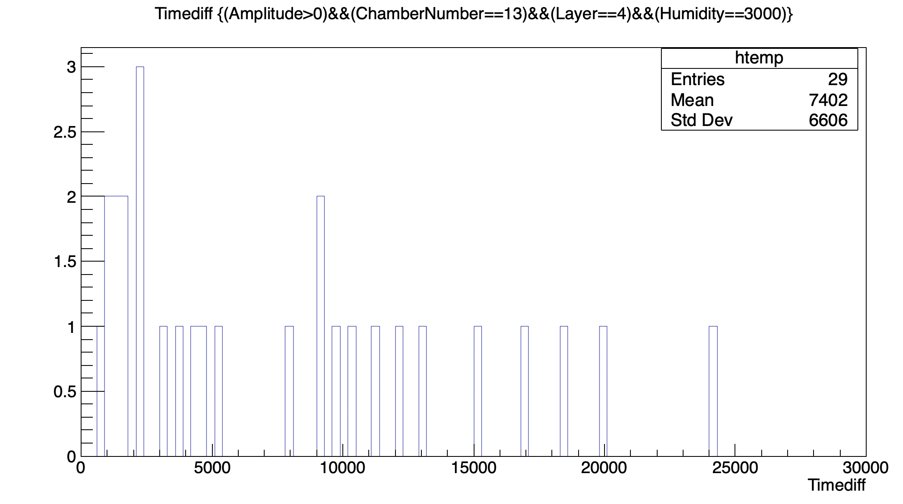
Timediff distribution at different Humidity

Slide 20
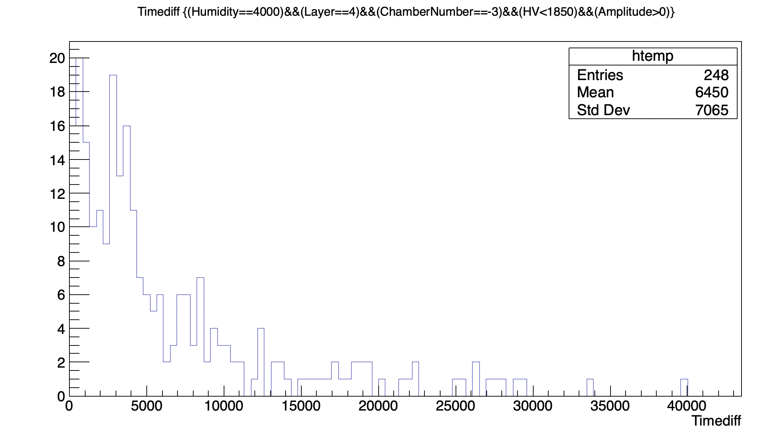
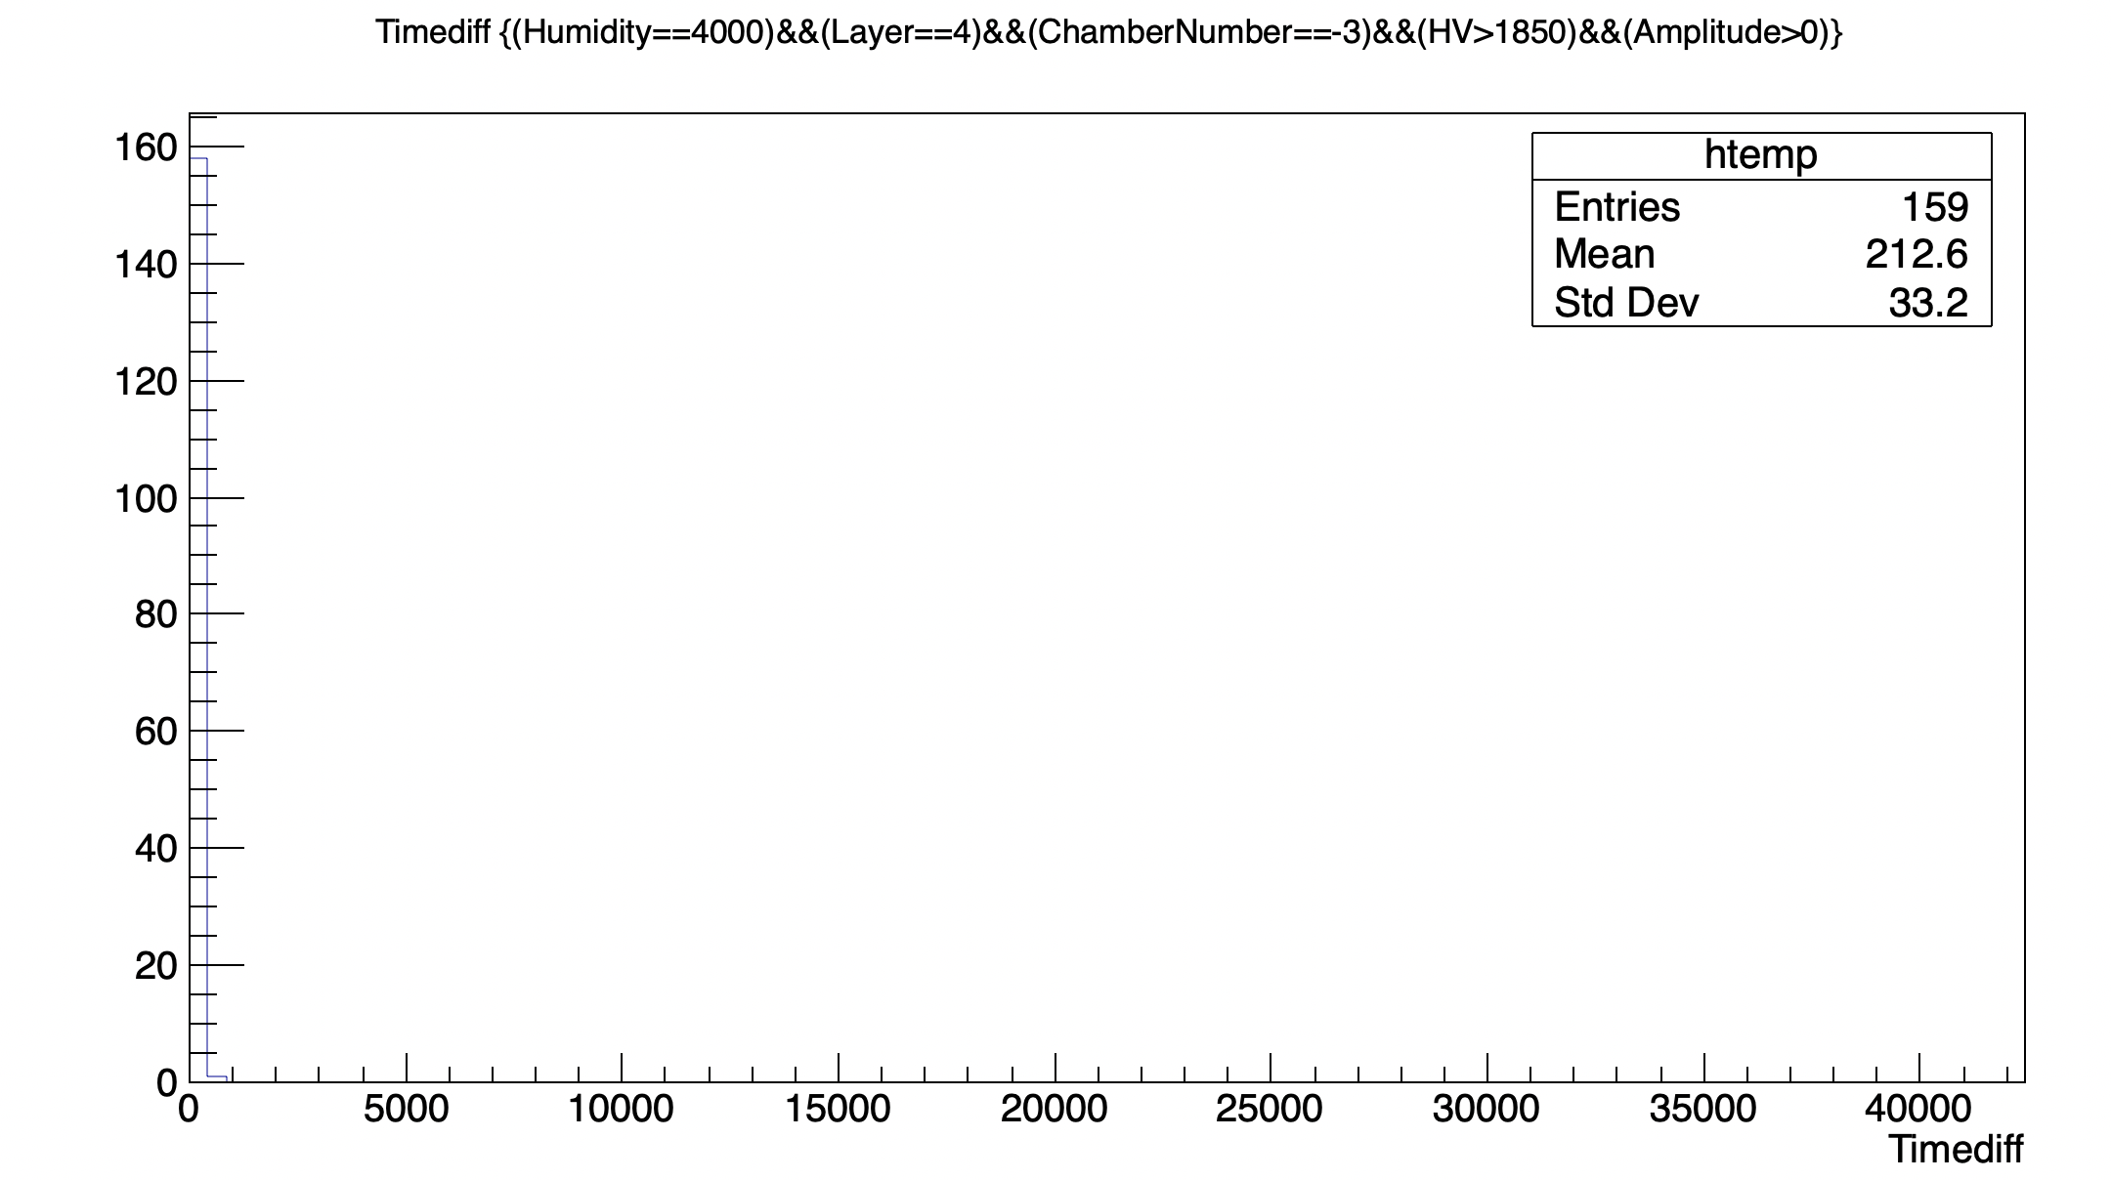
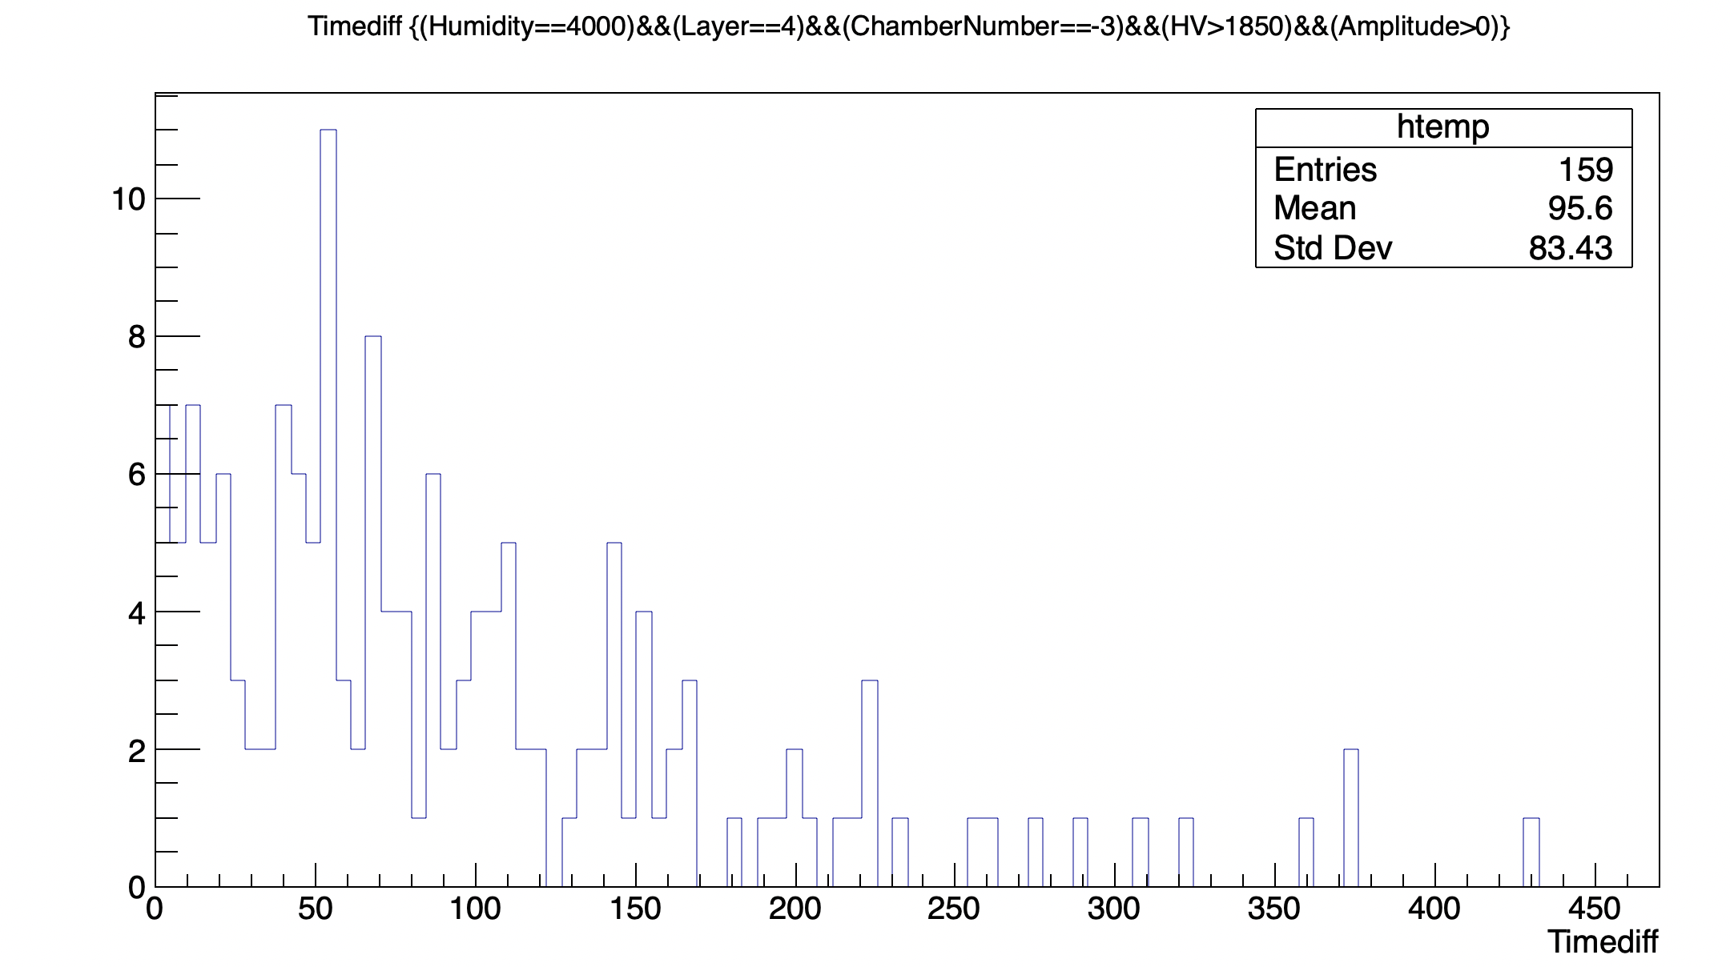
Timediff distribution at different HV

Slide 21
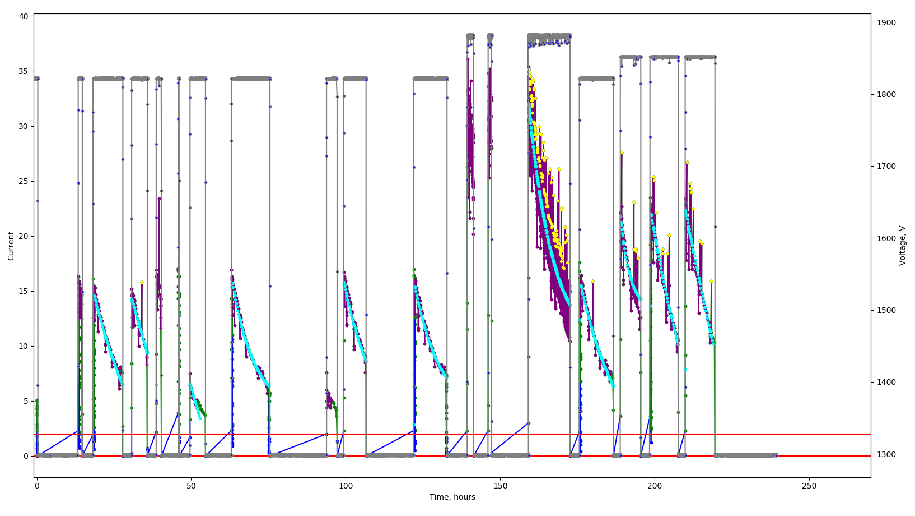
Count rate VS HV
How it looks like

Slide 22
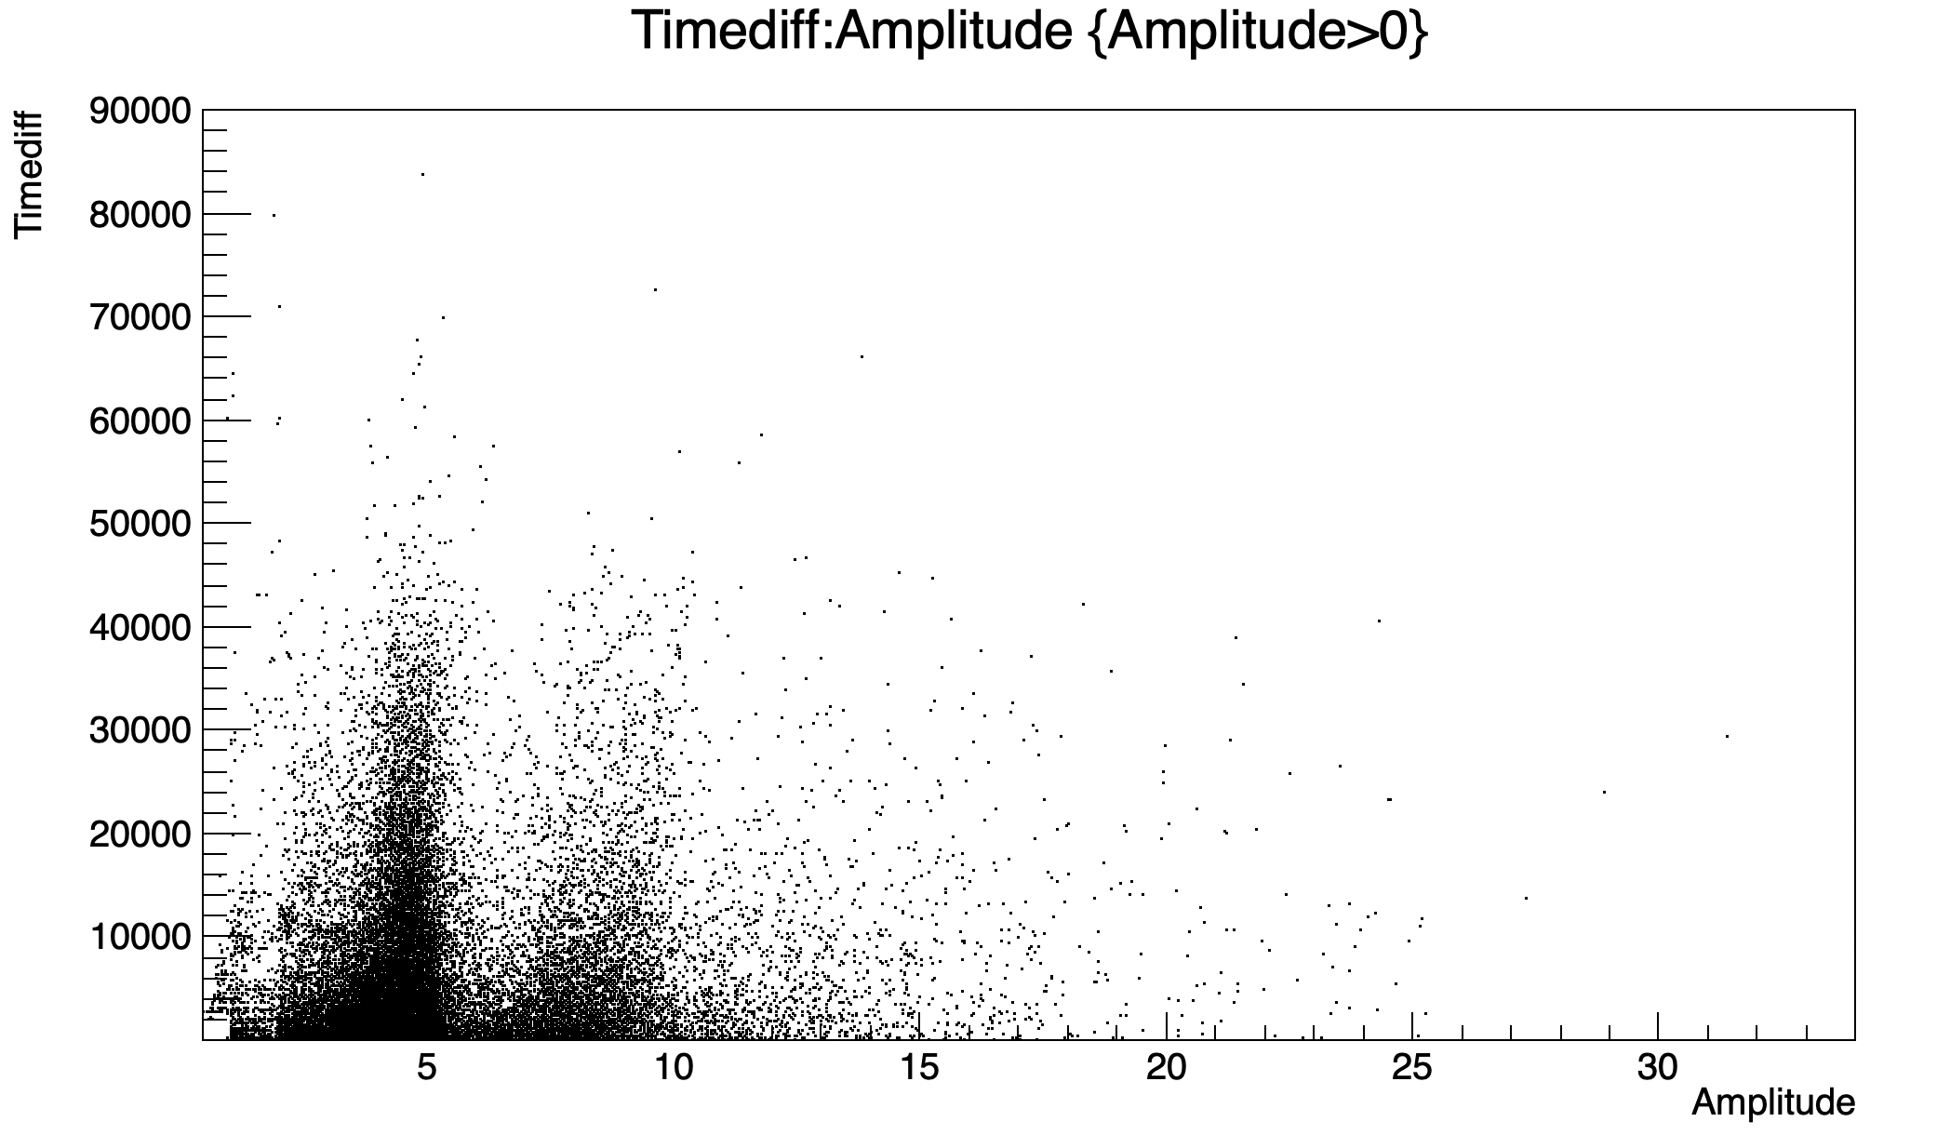
Timediff VS Amplitude

Slide 23
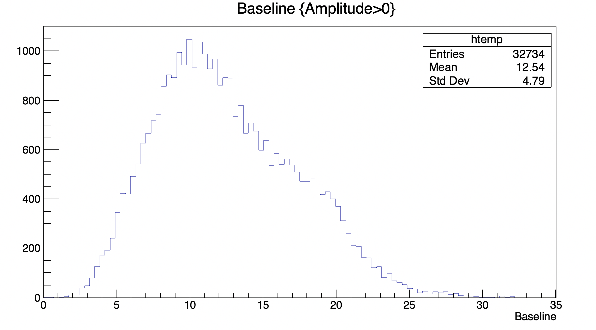
Baseline

Slide 24
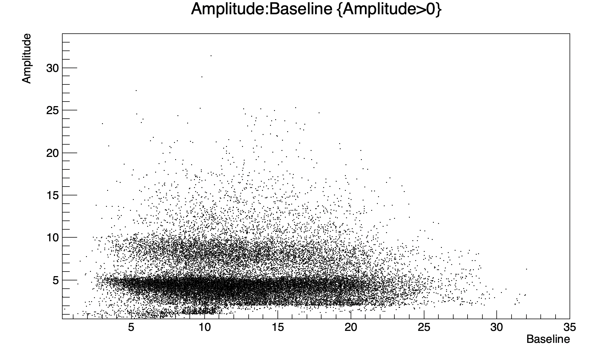
Amplitude VS Baseline

Slide 25
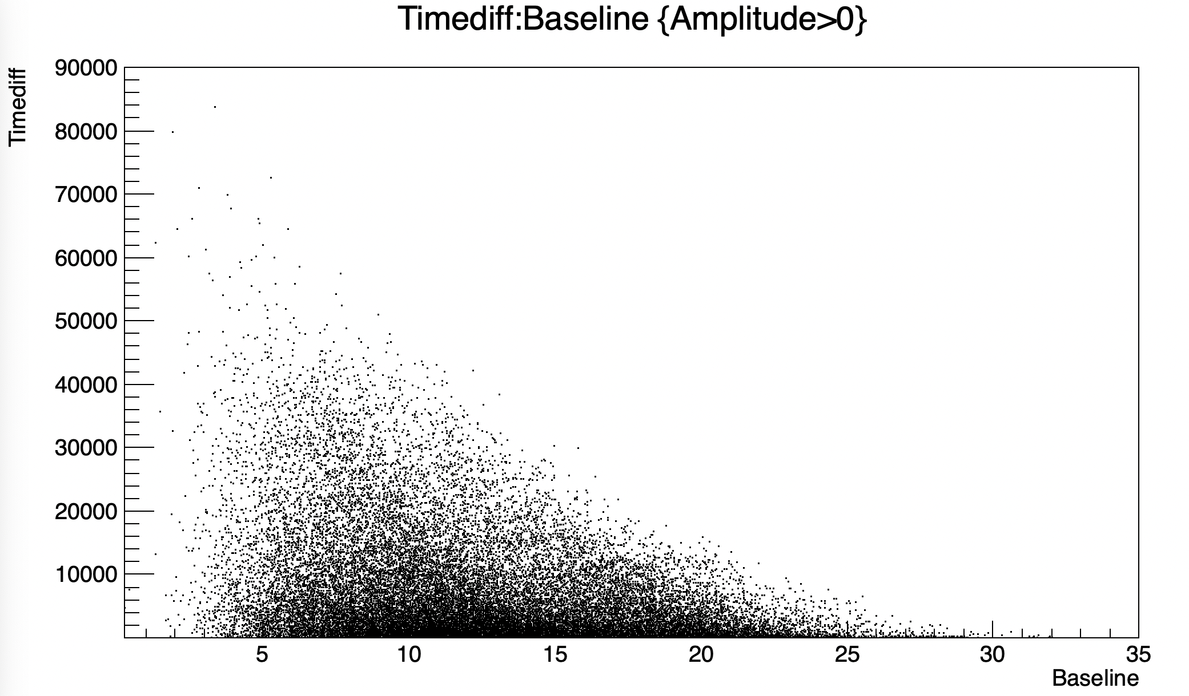
Timediff VS Baseline

Slide 26
Conclusion
Humidity increase:
don’t change the form of Amplitude distribution of the sparks;
leads to decrease of the sparks rate.
HV increase:
shortens the amplitude distribution of the sparks and make it more homogeneous;
significantly increases the sparks rate.
Baseline (Luminosity) increase:
doesn’t change the Amplitude distribution;
increases the sparks rate.

Slide 27
Thank you for your attention

